Slide 1
Fake Registration Plate and Traffic Rules Violation Detection
RNS INSTITUTE OF TECHNOLOGY
BENGALURU - 98
DEPARTMENT OF INFORMATION SCIENCE & ENGINEERING
Final Year Project Work Presentation
Candidate Names
Deepa G Warad : 1RN21IS040
Gokul B M : 1RN21IS051
Gunjana K E : 1RN21IS054
Jaswanth Alluri : 1RN21IS061
Internal Guide
Dr. Suresh L
Prof and HoD
Dept of ISE, RNSIT

Slide 2
AGENDA
Abstract
Introduction
Literature Review
Analysis
System Design
Implementation
Testing
Discussion of Results
National Conference Paper
Conclusion and Future Enhancements
References
Q & A

Slide 3
ABSTRACT
A fake registration plate detection system is a tool that is used to identify and document instances of fake or altered registration plates on vehicles.
These fake plates can be used to conceal the identity of a vehicle or evade detection by law enforcement and can pose a significant safety risk to other drivers on the road. Existing systems have various drawbacks, such as cost, accuracy, privacy concerns, limited effectiveness, and limited coverage.
To improve the effectiveness of fake registration plate detection, a proposed system could incorporate multiple methods of detection, also be designed to continuously monitor for fake registration plates in real-time, maintain a comprehensive and up-to-date database of valid registration plates, and be integrated with other systems such as traffic cameras or toll collection systems.

Slide 4
INTRODUCTION
Background
The increasing prevalence of fake or altered registration plates poses significant risks, as criminals often use them to evade law enforcement and engage in illegal activities, threatening public safety.
Current technologies like License Plate Recognition (LPR) and Automatic Number Plate Recognition (ANPR) leverage Optical Character Recognition (OCR) to capture vehicle registration data, but they face limitations such as high costs, accuracy issues, privacy concerns, and limited coverage.
Additionally, challenges include false positives and negatives, outdated databases of valid plates, and a lack of continuous monitoring.
To address these issues, there is a need for a comprehensive detection system that incorporates multiple methods, enables real-time monitoring, and integrates with existing infrastructure, such as traffic cameras and toll collection systems.

Slide 5
INTRODUCTION
Existing System
Visual Inspection: Law enforcement officers or trained personnel visually examine vehicles to identify fake registration plates, using either manual methods or technology like cameras and scanners.
License Plate Recognition (LPR) Systems: These systems deploy cameras and image recognition software to automatically scan and read the license plates of passing vehicles.
Radio-Frequency Identification (RFID) Systems: RFID tags or transponders attached to vehicle license plates transmit identification information to a reader, allowing for automated recognition.
Human-Machine Collaboration: This approach integrates human inspection with machine-based detection methods to enhance the identification process for fake registration plates.
Drawbacks: Current systems often face high implementation and maintenance costs, limited effectiveness, privacy concerns, and accuracy challenges.

Slide 6
INTRODUCTION
Proposed System
The proposed multimodal detection system would integrate various methods for identifying fake registration plates, enhancing both accuracy and effectiveness by covering a broader range of fraudulent plates.
By enabling continuous real-time monitoring, the system would be more adept at detecting and preventing the use of fake registration plates.
Additionally, maintaining a comprehensive and up-to-date database of valid registration plates would further improve detection capabilities.
This detection system could be integrated with existing infrastructures, such as traffic cameras and toll collection systems, to expand its coverage and effectiveness.
Furthermore, incorporating human expertise and judgment into the detection process could enhance the identification of more sophisticated or well-concealed fake registration plates.

Slide 7
LITERATURE SURVEY
Sl.No.z | Authors | Title and Year of Publication | Contents | Advantages | Disadvantages
1. | Gaurav Joshi, Shreya Kaul, Akansha Singh | Automated Vehicle Numberplate Detection and Recognition - 2021 | The VNDR concept utilizes computer vision techniques to detect and recognize characters on vehicle number plates. This paper reviews various methodologies aimed at improving the accuracy of number plate recognition, including image processing and character recognition techniques. Such systems have valuable applications in traffic management and law enforcement, offering insights and information from the collected data. | Automation of number plate detection and recognition. Versatile applications in traffic and law enforcement. Scalability for large-scale deployment. Real-time processing for quick responses | Sensitivity to environmental conditions. High initial implementation costs. Regular maintenance requirements
2. | Zillur Rahman , Amit Mazumder Ami, Muhammad Ahsan Ullah | A Real-Time Wrong-Way Vehicle Detection Based on YOLO and Centroid Tracking - 2020 | The development of an automatic wrong-way vehicle detection system that can be used in real-time traffic management. The system would use surveillance video footage from on-road cameras to detect and track vehicles and then use the You Only Look Once (YOLO) algorithm and a centroid tracking algorithm to identify wrong-way driving vehicles. | Real-time detection for immediate action High accuracy with YOLO and centroid tracking Enhances traffic safety by preventing accidents | Sensitive to lighting and weather conditions. High computational resource requirements. Risk of false positives in detection
3. | P.Srinivas Reddy, T. Nishwa, R. Shiva Kiran Reddy, Ch Sadviq, K. Rithvik | Traffic Rules Violation Detection using Machine Learning Techniques - 2021 | The proposed system would use computer vision techniques to identify common types of traffic violations in real-time, such as signal violations. The authors note that this system has the potential to be faster and more efficient than human traffic police officers, who may not be able to capture multiple violations simultaneously. | Real-time identification of traffic violations. More efficient than human traffic monitoring. Simultaneous detection of multiple violations | Sensitive to environmental conditions like lighting and weather High setup and maintenance costs Potential accuracy issues in complex scenarios

Slide 8
LITERATURE SURVEY
Sl No | Authors | Title and Year of Publication | Contents | Advantages | Disadvantages
4. | Waqar Riaz, Abdullah Azeem, Gao Chenqiang, Zhou Yuxi, Saifullah, Waqas Khalid | YOLO-Based Recognition Method for Automatic License Plate Recognition - 2020 | A new approach to automatic license plate recognition (ALPR) using a multi-task learning strategy. The proposed method uses the YOLOv3 model for license plate recognition and the CRNN model for classification. The authors used the AOLP (Application oriented License Plate) dataset for their experiments and report that their method outperformed Sighthound and Open ALPR by 9% and 4.9%, respectively. | Outperforms existing methods (Sighthound by 9%, Open ALPR by 4.9%) Multi-task learning integrates detection Uses YOLOv3 and CRNN for high accuracy | Dependent on the quality of the AOLP dataset High computational requirements Potential issues with non-standard or damaged plates
5. | M Keerthana, R Roshitha Akhileswari, I Surya, K Venkata Adharsh, D Satya Prasad | Fake and Stolen Number Plate Detection- 2023 | The proposed system automates the detection of unauthorized vehicle number plates, including fake, modified, and stolen plates. This system employs optical character recognition (OCR), machine learning, and image processing to expedite recovery. The study highlights the urgent need for automated systems in traffic management and law enforcement. | Automates detection of unauthorized, fake, or stolen vehicle plates Speeds up stolen vehicle recovery compared to manual searches Enhances public safety by preventing fraud and improving traffic enforcement | Relies on the quality of OCR and image processing techniques May face challenges in low-light or poor weather conditions High setup costs for implementing advanced technologies in traffic management
6. | Ruchita V. Patel, Asst. Prof. Saket J. Swarndeep | Literature Survey on Vehicle Recognition for Augmented Reality Using Android Smart Phones - 2020 | This paper discusses an application that integrates Optical Character Recognition (OCR) with Augmented Reality (AR) using Android smartphones to extract vehicle number plates. The process involves detecting and segmenting the number plate, normalizing characters, and recognizing them through template matching to produce encoded text. The aim is to enhance user experience and efficiency in recognizing vehicle plates in real-time. | Real-time vehicle plate recognition with OCR and AR Enhanced user experience and efficiency Versatile applications in toll, parking, and security zones | Dependent on smartphone camera quality Issues with damaged or non-standard plates Limited by smartphone processing power

Slide 9
LITERATURE SURVEY
Sl No | Authors | Title and Year of Publication | Contents | Advantages | Disadvantages
7. | Waqar Riaz, Abdullah Azeem, Gao Chenqiang, Zhou Yuxi, Saifullah, Waqas Khalid | YOLO-Based Recognition Method for Automatic License Plate Recognition - 2020 | A new approach to automatic license plate recognition (ALPR) using a multi-task learning strategy. The proposed method uses the YOLOv3 model for license plate recognition and the CRNN model for classification. | Outperforms existing methods (Sighthound by 9%, OpenALPR by 4.9%) | Relies on the quality of the AOLP dataset High computational requirements for YOLOv3 and CRNN
8. | Sanjid Bin Karim Sezan, Tisha Rahman, Kazi Tanvir, Nishat Tasnim, Al-Jobair Ibna Ataur | Detecting Traffic Rule Violations and Promoting Road Safety through Artificial Intelligence - 2023 | Bangladesh faces significant traffic rule violations due to chaotic roads and a lack of enforcement, leading to a high accident rate. The study proposes using YOLOv5, a machine learning model, to detect violations such as red-light running and illegal parking in real-time. | Real-time detection of traffic violations (illegal parking) Enhances road safety by automating violation monitoring | Dependent on the quality of surveillance footage and lighting conditions High computational requirements for real-time processing
9. | Mr. M. V. Rajesh, Mr. T. Soma Sekhar, Ms. P. Mounika Devi, Ms. Y. Mounica Bhavani, Mr. R. S. S. V. S. S. Narendra, Mr. K. Bulli Raju | Traffic Rules Violation Detection System - 2022 | This paper presents a Traffic Rules Violation Detection System that leverages computer vision techniques to identify traffic violations in real time. Using YOLOv3 for vehicle detection, the system captures video footage to detect violations like running red lights. It includes a user-friendly GUI for effective management and monitoring | Uses YOLOv3 for efficient vehicle detection User-friendly GUI for easy management and monitoring | Performance may degrade under poor lighting or weather conditions Limited effectiveness in complex traffic scenarios or crowded areas
10. | Mavis Nyamesah, Christian Kusi | Real-Time Traffic Rules Violation Detection with Automatic License Plate Recognition with SMS Feedback - 2024 | This paper presents an automated traffic violation detection system using computer vision and machine learning, particularly Convolutional Neural Networks (CNNs). It detects real-time violations, like signal infractions, in urban areas with growing vehicle populations. | Uses CNNs for accurate violation identification Suitable for urban areas with increasing vehicle populations | Requires high computational resources for real-time processing Dependent on the quality of video footage and environmental conditions

Slide 10
Analysis
Problem Identification
The system tackles the issue of fake or altered registration plates, which create safety hazards for drivers and complicate law enforcement efforts.
These plates can disguise a vehicle's identity, making it challenging to identify traffic violators. Unlicensed or reckless drivers might use fake plates to avoid detection, raising the risk of accidents.
Furthermore, criminal organizations could misuse them to obscure the identities of vehicles involved in illegal activities, posing a threat to public safety.
Objectives
The main goal of a fake registration plate detection system is to eliminate the use of fake or altered plates on vehicles.
This ensures accurate vehicle records, as such plates can hide a vehicle's identity. Additionally, they may facilitate criminal activities by helping offenders evade law enforcement.
Improving road safety is another priority, as vehicles with fake plates may lack proper inspections or be in poor condition, posing risks to other drivers. Finally, addressing fake plates is essential for enforcing traffic laws, as they allow violators to evade fines, undermining road safety efforts.

Slide 11
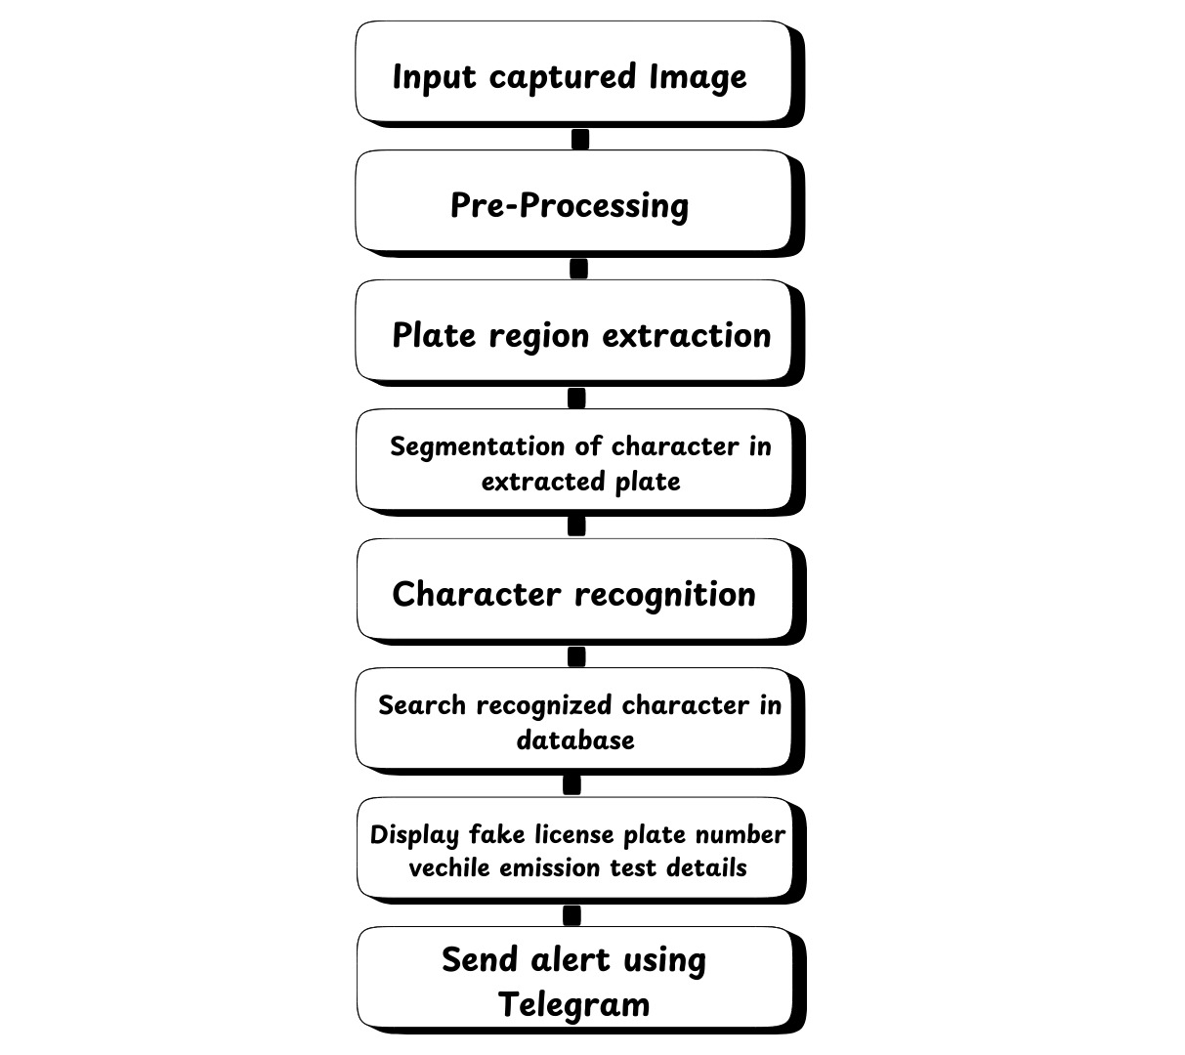
ANALYSIS
Methodology

Slide 12
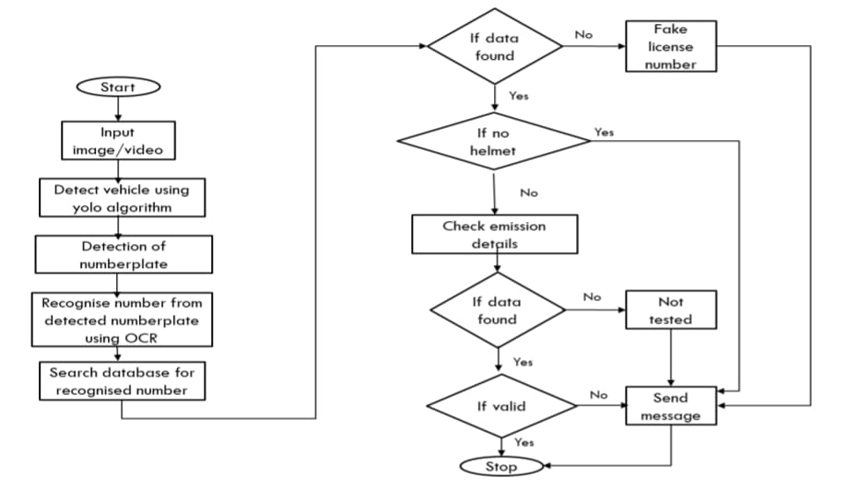
ANALYSIS

Slide 13
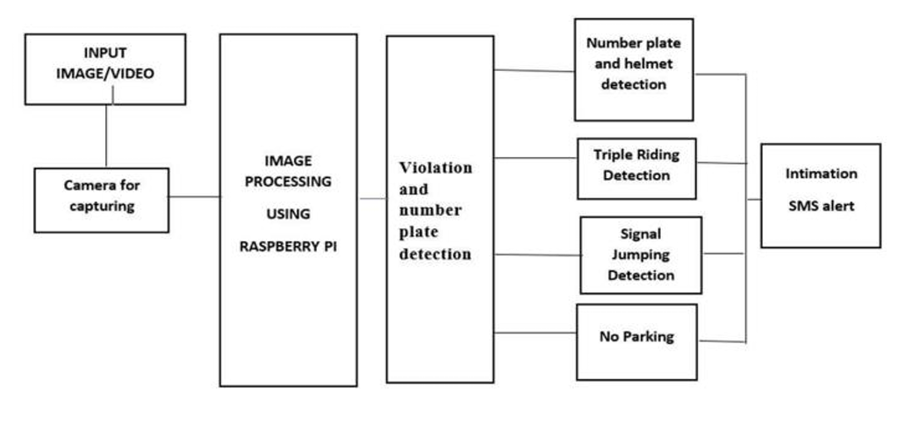



System Design
Fake plate detection
Riding without helmet
Emission test

Slide 14
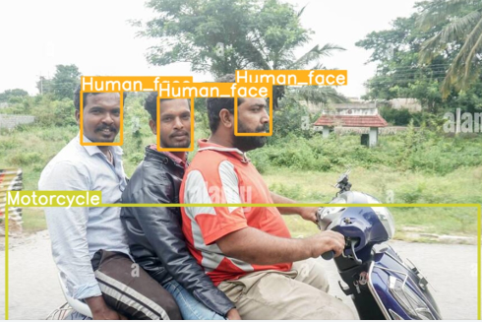
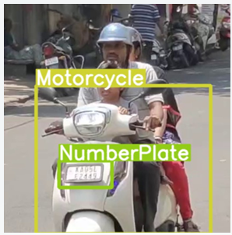
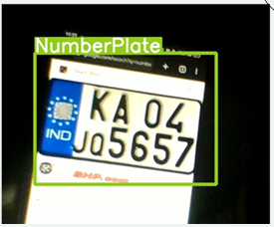
Implementation
Computer vision and machine learning techniques can be used to automatically identify and classify different types of vehicles. Object detection algorithms such as YOLOv3 can be used to detect vehicles in real-time. The system can classify vehicles into different categories such as cars, trucks, motorcycles, and buses.
Figure - Optical character recognition can be used for character recognition on the extracted number plate
Figure - Object detection algorithm such as YOLOv3 can be used to detect motorcyclists and helmets in real time
Figure - Realtime detection of Vehicles and Number plates

Slide 15
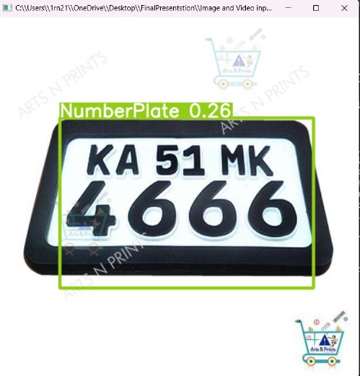
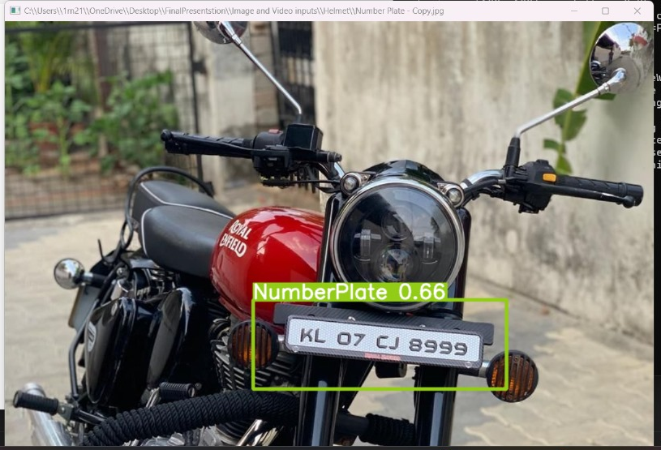
Results and Discussions

Slide 16
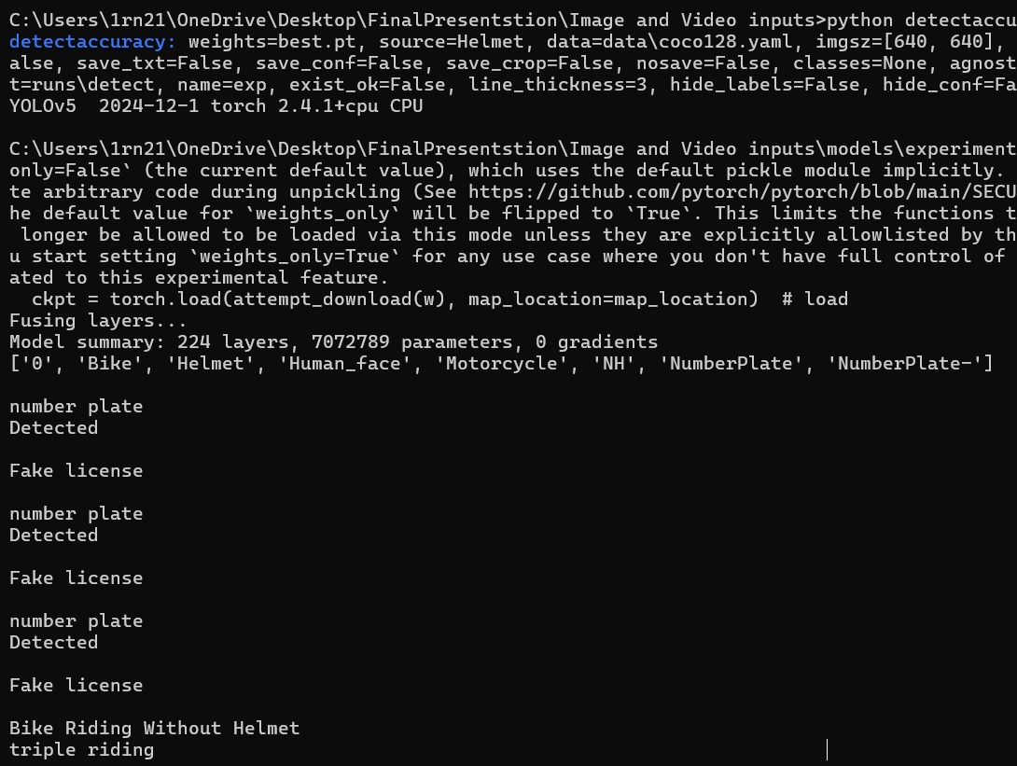

Results and Discussions

Slide 17
CONCLUSIONS
The implementation of a fake registration plate detection and traffic rules violation detection system offers several critical benefits:
Deterrence: By detecting and penalizing the use of fake plates, the system discourages future violations.
Enhanced Road Safety: Identifying vehicles with fake registration plates helps reduce the risk posed by unlicensed or reckless drivers, contributing to fewer accidents and injuries.
Support for Law Enforcement: The system provides essential tools and information to law enforcement agencies, improving their ability to enforce traffic laws effectively.
Public Safety Protection: By tracking vehicles potentially involved in criminal activities, the system enhances public safety and security.
Real-time Alerts: The capability to generate notifications ensures that authorities are promptly informed of any detected fake registration plates, facilitating swift action.
In summary, this system not only addresses the issue of fake registration plates but also contributes significantly to overall road safety and law enforcement efficiency.

Slide 18
Future Enhancements
Cloud-Based Systems: Leveraging cloud computing for storing and processing large data volumes, enabling faster analysis and greater scalability.
Advanced Analytics: Integrating predictive analytics to forecast violations or trends, facilitating proactive traffic management and enforcement.
Enhanced Privacy Features: Implementing robust data protection measures and anonymization techniques to address privacy concerns while ensuring system effectiveness.
Machine Learning Integration: Utilizing machine learning algorithms to continuously improve detection accuracy and adapt to new patterns of fake plate usage.
Real-Time Alerts: Enhancing immediate notifications to law enforcement agencies when fake plates are detected, allowing for timely interventions.
Mobile Applications: Developing mobile applications for easier access to the system by law enforcement officers in the field, enhancing responsiveness.
Public Awareness Campaigns: Implementing educational programs to inform the public about the dangers of fake registration plates and the importance of compliance.

Slide 19
REFERENCES
(In IEEE Standard format only)
[1] Automated Vehicle Numberplate Detection and Recognition - 2021
[2] A Real-Time Wrong-Way Vehicle Detection Based on YOLO and Centroid Tracking - 2020
[3] Traffic Rules Violation Detection using Machine Learning Techniques - 2021
[4] YOLO-Based Recognition Method for Automatic License Plate Recognition - 2020
[5] Machine Learning-based Surveillance System for Detection of Bike Riders without Helmets and Triple Rides – 2020
[6] Vehicle Number Plate Recognition System: A Literature Review and Implementation Using Template Matching
[7] Fake and Stolen Number Plate Detection- 2023
[8] Literature Survey on Vehicle Recognition for Augmented Reality Using Android Smart Phones - 2020
[9] License Plate Recognition System-Survey - 2021
[10] A Survey On Automatic Vehicle Number Plate Detection System- 2017
[11] YOLO-Based Recognition Method for Automatic License Plate Recognition - 2020
[12] Detecting Traffic Rule Violations and Promoting Road Safety through Artificial Intelligence - 2023
[13] Detecting Traffic Rule Violations and Promoting Road Safety through Artificial Intelligence - 2023
[14] Traffic Rules Violation Detection System – 2022
[15] Intelligent Traffic Violation Detection - 2021

Slide 20

Question and Answer

Slide 21


